Slide 1



MCSE 666:Pattern and Speech Recognition
Introduction to Pattern Recognition
Dr. Md. Aminul Haque Akhand Dept. of CSE, SUB

Slide 2
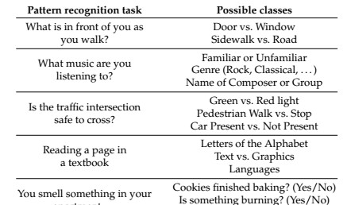
What Is Pattern Recognition?
2
Pattern recognition (PR) is a process by which some input is measured, analyzed, and then classified as belonging to one of a set of classes
Process of PR and classification is a continual, never ending
aspect of every-day human existence:

Slide 3
What Is Pattern Recognition? Cont.
3
PR as a human experience refers to a perceptual process: some form of sensory input is sensed, analyzed, and recognized (classified), either subconsciously (by instinct) or consciously (based on previous experience).
Patterns may be presented in any sensory modality: vision, hearing, touch, taste, or smell.
PR as a technical discipline: a process in which an input object is measured, analyzed, and classified by a machine as being more or less similar to some class in a set of classes.

Slide 4
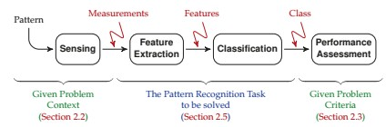
Pattern Recognition Framework
4
The goal of PR is to provide a machine with a kind of perceptual capability to automatically extract useful information from measured data.

Slide 5
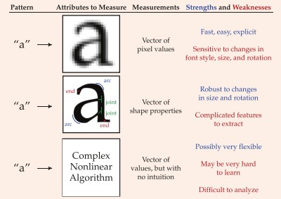
5
PR Illustration with Example
Pattern Recognition of Text

Slide 6

PR Illustration with Example
6
Pattern Recognition of the Mind
It deons’t mettar in waht oerdr the lrttees in a wrod are, as lnog as the frist and lsat ltteres rmeain in the rgiht pacle.
The retina in the eye is densely packed with light-sensitive cells, so that it may be tempting to think
Our brain effectively sees and perceives the world as a great many pixels.
There are many simple mind tricks or optical illusions

Slide 7
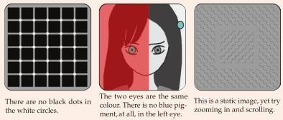
PR Illustration with Example
7
Pattern Recognition of the Mind
The eye is not just sending pixellated images to the brain.
There is a great deal of feature extraction taking place, much already in the retina
It is very helpful in running through a forest, but perhaps not so useful in staring at deliberately manipulated images on a page.

Slide 8

Features from Patterns
8
The word “pattern” may bring to mind texture, fabric, or shape.
In the context of pattern recognition, the notion of pattern is far more broad, and can apply to any thing that can be distinguished from another thing.
Identity view point: infer the unknown identity of an object
Type of wildflower, type of songbird, or the name of the person facing a camera — each of these has a certain identity to determine from measurements.
A pattern is assumed to have certain properties or
attributes which distinguishes it from other patterns.

Slide 9
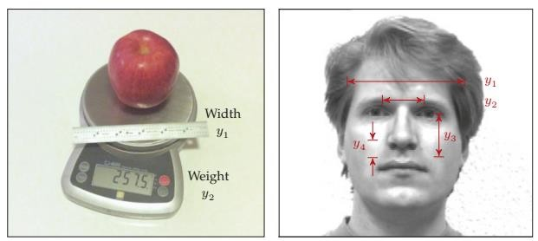
Features from Patterns (Cont.)
9
One or more measurements are taken of a pattern
Size / weight of a piece
Various dimensions from face
Does all measurements from patterns important to distinguish?

Slide 10
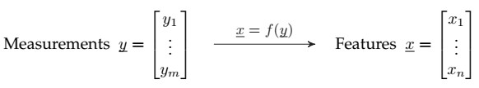
Features from Patterns (Cont.)
10
The selection of appropriate measurements is an essential
Measurements may cost money and/or time, and
Poor measurements lead to poor performance of the resulting classifier.
The process of transforming measurements into features facilitate classification, normally in one or both of the following ways:
By reducing the dimensionality of the problem: n < m
By creating
features in which patterns are more clearly
distinguished.

Slide 11
Features from Patterns (Cont.)
11
The feature extraction function f() can focus the information from x, or it can remove irrelevant information from x, but f() never adds information.
Data Processing Theorem: x can never have more
information than was present in y.
An effective feature extraction function f() can make the PR problem easier,
However, in principle, the best possible classifier based on the measurements y should perform at least as well as the best possible classifier based on the features x.

Slide 12


Features from Patterns (Cont.)
12
Features may be intuitive or they may be quite abstract.
Consider, the measurements of an electric motor:
Power as Feature: Understandable
Uninterpretable feature do not
make any physical sense,
But perhaps be effective as a feature for classification.

Slide 13
Classes and Classification
13
The whole purpose of PR or classification consists of
assigning an object to a class.
A class is a particular pattern, or possibly a group of patterns which are similar or equivalent in some sense.
In a given problem, the set of classes C is defined as
C = {C₁; C₂; -; -; -; -; C_{K} };
Have to choose one class from K different classes.
Members of a class share some common properties or attributes
In PR problems the class set C is predefined and has been specified as part of the problem to be solved.

Slide 14
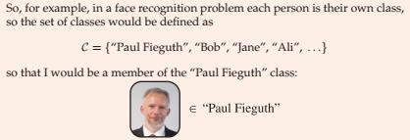

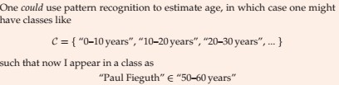
Classes and Classification
14

Slide 15
Classes and Classification
15
Way of Describing Classes
Via Prototype Idealized representation or notion of the “essence” of the class. Pros: each class is unambiguously defined, Cons: no scope for variability.
Via Parameterized Shape: A generalization of the prototype; the class has a known shape (e.g., rectangular or elliptical), the shape is described in some number of parameters (e.g., ellipse centre, rotation, and axis lengths). Pros. more flexible than that of a single prototype, Cons: still requires the type of shape to be assumed or known.
Via Statistical Distribution: Some description of the likelihood or probability of a class member having a particular set of measurements or features. Pros.: very comprehensive, Cons: There will be circumstances when the statistics are not known and may be difficult to infer.
Via Samples: A set of given samples (many apples, or tigers, or bicycles) directly characterizes the class. Pros: Highly convenient, since nothing further needs to be done to describe the class Cons: Storage and computational challenges, since all of the data need to be saved.

Slide 16
Classes and Classification
16
Variability in a Class
Patterns do not need to be identical to belong to the same class: not all pictures of a person the same, or of tigers, or of apples.
There are at least two sources of variability present in the measurements associated with a single class:
The inherent variability within a class: Every class will consist of members which differ in some way. The degree and nature of the inherent variability will depend greatly on the class definition.
“Fruit” class contains all manners of variability in colour, size, and shape; “Apple” class is much more specific, but apples do come in different colours and patterning; the “Granny Smith Apple” class is even more specific, but still will have apples of different sizes or with more or fewer blemishes.
Noise or random variations in measurement: Every measurement
involves some sort of physical process which will be subject to error, such as thermal noise in electronics, or quantization noise in converting an analogue signal to a digital representation.

Slide 17
Classifier and Classification
17
In PR tasks the class set C is predefined and has been specified as part of the problem to be solved.
A classifier is some function g(), possibly analytical (i.e., an equation) or a computer algorithm, which assigns a class label to a given feature:
g(x) ∈ C = {C₁; C₂; : : : ; C_{K}}
There is a strong relationship between feature extraction and classification, such that
Good features allow for simpler classifiers, whereas
Complex classifiers can compensate for weaker features, which are unable to fully separate the pattern classes.

Slide 18
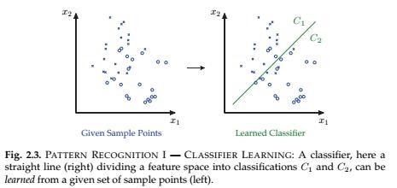
Classifier and Classification
18
Two Fundamental Steps Associated With Classification:
I. Classifier Learning and II. Classifier Testing or Validation

Slide 19
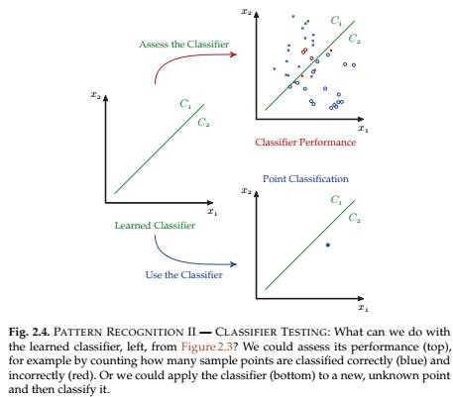
Classifier and Classification
19
II. Classifier Testing or Validation

Slide 20
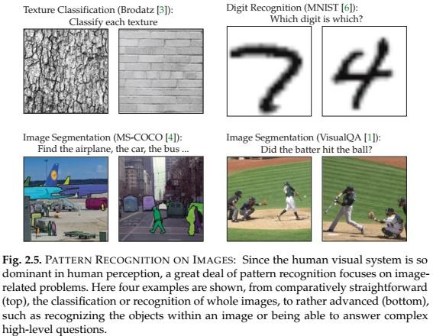
Classifier and Classification
20
Illustrative Examples of Classification

Slide 21
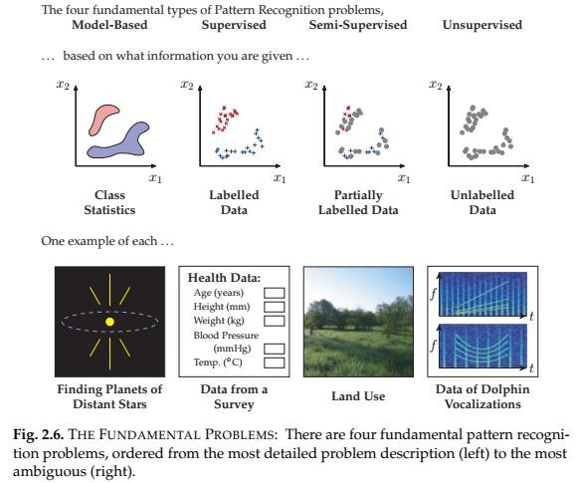
Classifier and Classification
21
Pattern Recognition Problems
Four Fundament Types PR Problems:
Model-Based
Supervised
Semi-Supervised
Unsupervised

Slide 22
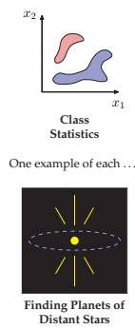
Classifier and Classification
22
Pattern Recognition Problem: Model-Based
Scenario 1 (Model-Based): Model is known or given
Hope to have most information regarding a PR problem the behaviour of the measurements for each of the pattern classes.
Normally characterized in a statistical fashion, such as p(y|C) = The distribution of measurement vector y given class C
Such detailed information will be available only in those contexts where the physical process is known by which a given pattern class gives rise to measurements.
Very convenient to have detailed information, since statistical decision theory allow to explicitly define the optimal classifier, in the sense of minimizing the probability of classification error

Slide 23
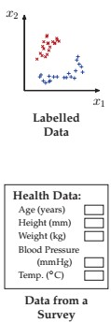
Classifier and Classification
23
Pattern Recognition Problem: Supervised
Scenario 2 (Supervised): Model is not known, labelled data are available
Do not have an exact description of the problem,
as in Scenario 1
Given labelled data, meaning data pairs of the form
{y_{i}; C_{κ}} -> The ith measurement vector y_{i} is in class C_{κ}
Labelled data do not just magically appear; labelled or tagged by a human observer, so refer scenario as supervised
Exceptionally expensive or labour-intensive with larger datasets.
May derive a classifier directly from the given labelled or learn an empirical probability model as of Scenario 1

Slide 24
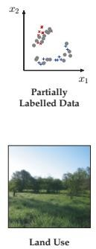
Classifier and Classification
24
Pattern Recognition Problem: Semi-Supervised
Scenario 3 (Semi-Supervised): Model is not known,
some are labelled data, some are not
Labelled data can be expensive, requiring manual labelling. A huge data be unlabeled and Scenario 2 ignores all unlabeled data.
Problem refers to as semi-supervised when some
degree of human input is required
In semi-supervised case, a small set of samples have been manually labelled for classification (e.g., face images tagged by a human observer), but then also to leverage a very large set of unlabeled data

Slide 25
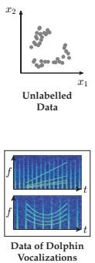
Classifier and Classification
25
Pattern Recognition Problem: Unsupervised
Scenario 4 (Unsupervised): Model is not known, no labelled data available
Pattern measurements are available, however the points have no associated class information; this is known as an unsupervised problem.
The range of problems here is still very broad, depending on whether we are told the number of classes, or their typical size or separation, or perhaps nothing at all.
Clustering problems are in Unsupervised category

Slide 26
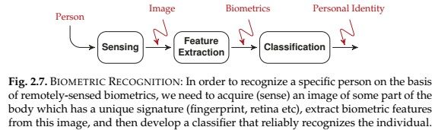
PR Case Study: Biometric Recognition
26
Biometrics
Basic Components of Biometric Recognition:
Face
Fingerprint
Iris (the colored region in your eye
around the pupil)
Retina (the pattern of arteries in the back of your eye)
Veins (vein structure in hand or arm)
DNA
Image Acquisition
Feature Extraction
Classification
The classifier returns one member of the class set
C = {NoMatch; Person₁; Person₂; : : : ; Person_{K}}
Classifying x as NoMatch where Person1 is correct: Frustration Classifying x as Person2 where Person1 is correct: Security Breach

Slide 27

PR Case Study: Biometric Recognition
27
Classifying x as NoMatch where Person1 is correct: Frustration Classifying x as Person2 where Person1 is correct: Security Breach
Avoiding frustration and security breaches, a successful biometric strategy must also satisfy
Universality: Every person should be measurable, regardless of age and health
Uniqueness: The feature vectors extracted for a given person
should be robustly unique
Consistency: For a given person the feature vector should be highly repeatable from one try to the next, and should be slowly (or not at all) varying over time.
Other criteria: non-invasiveness, social acceptability, or how easily the system would be to defeat via nefarious means and so on

Slide 28
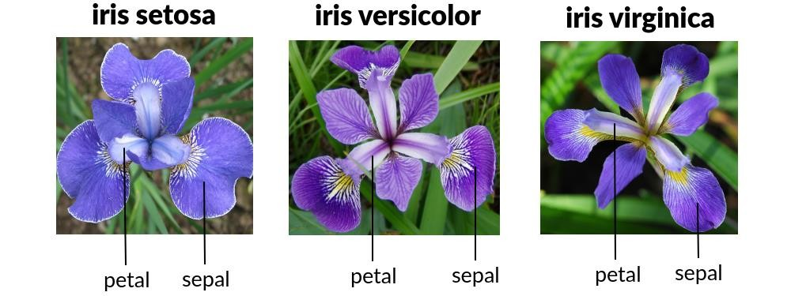
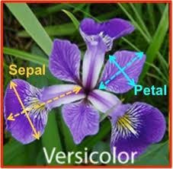
PR Hands-on: Iris Flower Recognition
28
C = {C₁; C₂; C₃} = {“Iris Setosa”, “Iris Versicolor”, “Iris Virginica”}
Each plant four measurements were taken:
Sepal Length Sepal Width Petal Length Petal Width
y =

Slide 29
Open Discussion
29

